Slide 1




Outubro 2025

Slide 2

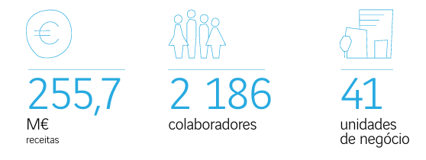




Sobre a VINCI Energies em Portugal
As nossas business lines
ICT
Smart Industry Solutions
Smart Energy Infrastructures
Smart Building Solutions

Slide 3

Principais tendências e abordagem da VINCI Energies em Portugal
Emergência ambiental
Expectativas sociais e dos colaboradores
Transformação digital e transição energética

Slide 4







Ambição Ambiental da VINCI Energies em Portugal
TEMAS MATERIAIS
Alterações climáticas e emissões GEE
Gestão da energia e eficiência energética Proteção da biodiversidade
Agir pelo clima
Reduzir as nossas emissões de GEE
\ Âmbitos 1+2*: 2018 -50% 2030
\ Âmbito 3**: 2019 -20% 2030
* emissões diretas e indiretas ligadas ao nosso consumo de energia
** emissões indiretas (fornecedores e clientes)
Economia circular
Otimizar recursos através da economia circular
\ Valorizar 80% dos nossos resíduos:
\ Inertes
\ Não Perigosos
\ Tratar 100% dos resíduos Perigosos
Ambientes naturais
Preservar o ambiente natural
\ Reduzir a nossa pegada hídrica
\ Proteger a biodiversidade

Slide 5
INICIATIVAS AXIANS

Slide 6

Iniciativas AXIANS
Descarbonização da frota

Slide 7

Iniciativas AXIANS
Postos de carregamento
Objetivo: 100% viaturas elétricas
CARTÕES
GALP Frota
EVIO

Slide 8

Iniciativas AXIANS
Soluções de soft mobility
Bolt Business
UBER para empresas
Passe para transportes públicos

Slide 9

Iniciativas AXIANS
Sensibilização e informação aos colaboradores
Framework Ambiental
Newsletters Ambientais
Formações
Webinars
Sessão integração de novos colaboradores
Eventos

Slide 10
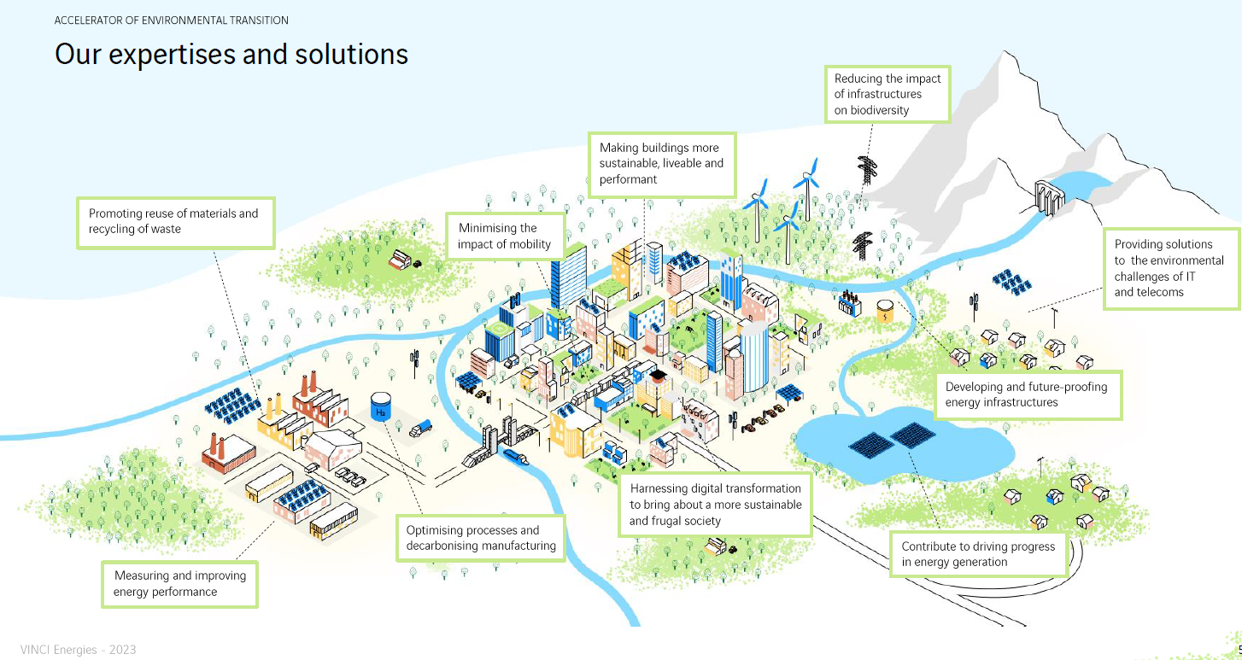
Green Offers

Slide 11
MOBILITY SOLUTIONS

Slide 12
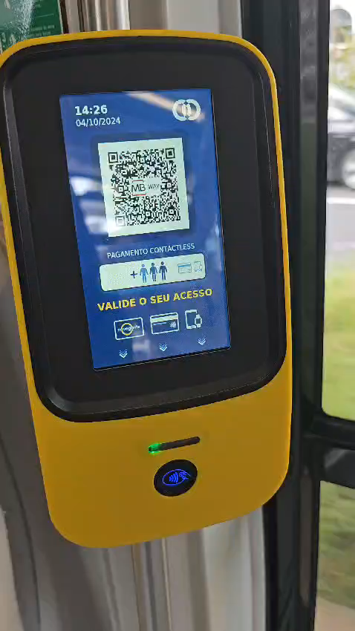



AXIANS MOBILITY DIGITAL SOLUTIONS FOR GREENER MOBILITY
A leading ticketing solutions provider, integrated in Vinci group, with more than 25 years of experience
TICKETING SOLUTIONS
Fully integrated solutions (open-loop, closed-loop)
Validation and sales
Driver consoles
SAE | operations
Passenger information
Driver behaviour, accident prevention, predictive maintenance, …
Communications
Proprietary validation and sales HW solutions
Turnkey integration of third-party solutions
ICT SYSTEMS
Bespoke intelligent business and operations management systems
(central systems)
Contactless payment solutions (EMV/mass transit)
FUL SERVICE CONTRACTS
Installation, maintenance and field services for full-service outsourcing
12

Slide 13

AXIANS MOBILITY OUR CLIENTS | LISBON
~600 K
PASSENGERS PER DAY
300+ M
TRANSACTIONS PER YEAR GO THROUGH OUR SYSTEMS
60%+
PUBLIC TRANSIT TRIPS IN AML
2 500+
VEHICLES FROM DIVERSE OPERATORS
5 000+ DEVICES

Slide 14
AXIANS MOBILITY OUR FOOTPRINT | PUBLIC TRANSPORTATION
Transport accounts for about 25% of CO2 emissions
Of these, 72% are based on road transport
And of these, 61% originate from cars
Source: EU Pocketbook 2025

Slide 15
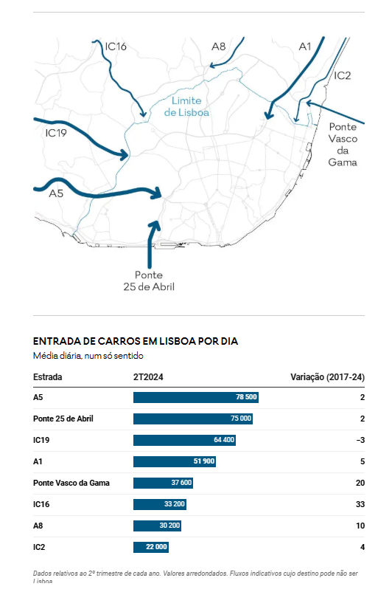
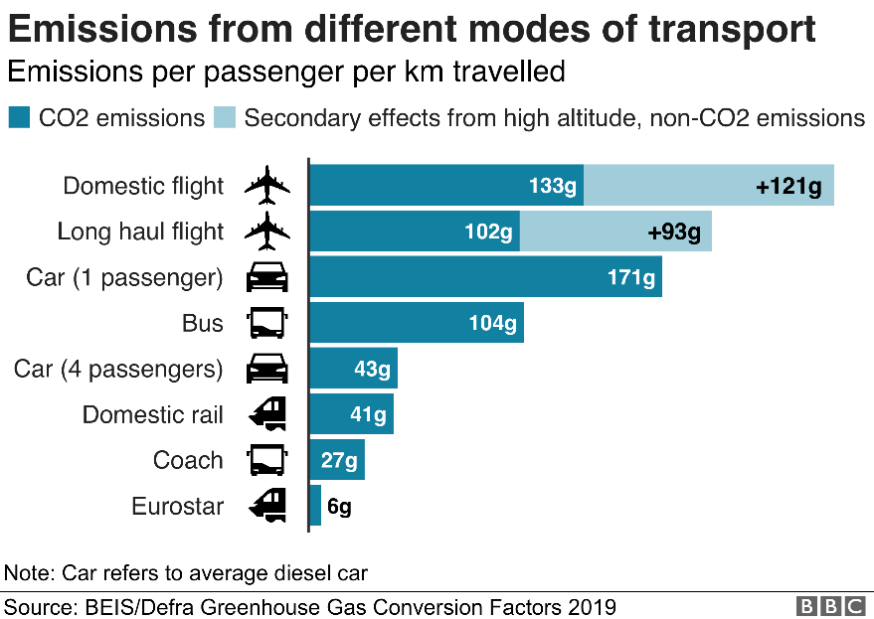
AXIANS MOBILITY OUR FOOTPRINT | PUBLIC TRANSPORTATION
Public Transport is key for sustainable mobility…
…and decarbonization is at a fast pace
In 2023, 87.2 % of trips (pass.km) in Portugal by car
On an average day, 390+ thousand cars enter the city of Lisbon
Source: EU Pocketbook 2025, Expresso,

Slide 16
AXIANS MOBILITY OUR FOOTPRINT | LISBON
OUR ROLE
-450 K* ton CO2eq / Yr.
(-55%)
BETTER SOLUTIONS FOR BETTER SERVICES: PUBLIC TRANSPORT A KEY PLAYER OF MOBILITY TRANSFORMATION
60%+ TRIPS IN GREATER LISBON AREA GO THROUGH OUR SOLUTIONS
C value: 34 M EUR / Yr. (est.)
* SIMPLIFIED SCENARIO

Slide 17
OBRIGADO

